Slide 1
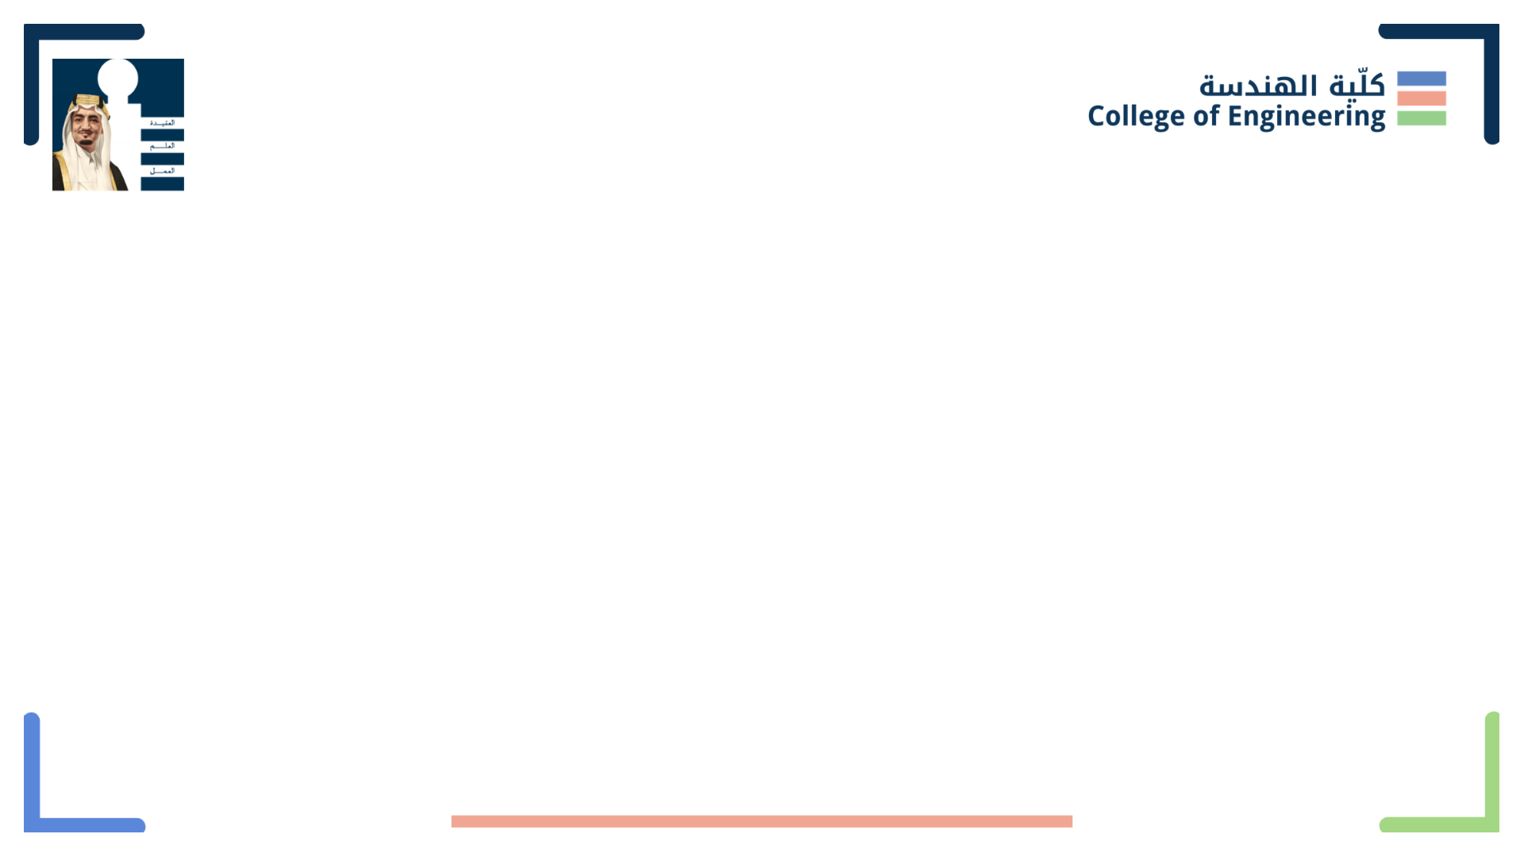
لغتي إشارَتي
Layali Elkordy
Bayan Al Shikh Zien
Reema AlOtaibi

Slide 2
Problem Statement
Deaf and mute citizens usually face difficulties communicating with others via sign language, as our community lacks this knowledge. Although 360 million, which is more that 5% of the world’s population are deaf/mute, sign language is not a universal language, and each language has its own gestures for the letters.
As technology is evolving, and different solutions have been designed to help conquer this problem in many languages, there is still no similar technologies for Arabic language.

Slide 3
Proposed Solution
Creating a model that can recognize hand gestures which represents different Arabic letters through a camera lens. The model will connect the captured letters to form a sentence or a word.
The main purpose of Loghati Esharati “لغتي إشارَتي” is to help people who lack the knowledge of sign language to understand and be able to communicate with deaf and mute people.

Slide 4

Approach
Define the Problem
Collect Data
Label the Data
Train the Initial Model
Model Initial Testing
Improve the Dataset
Test the Final Model
Build Software for Our Model

Slide 5
Define the Problem
It’s hard to communicate with deaf mute people without previous experience in Arabic sign language, so we need to find a solution that help to recognize and understand the gestures used to represent the Arabic letters.

Slide 6
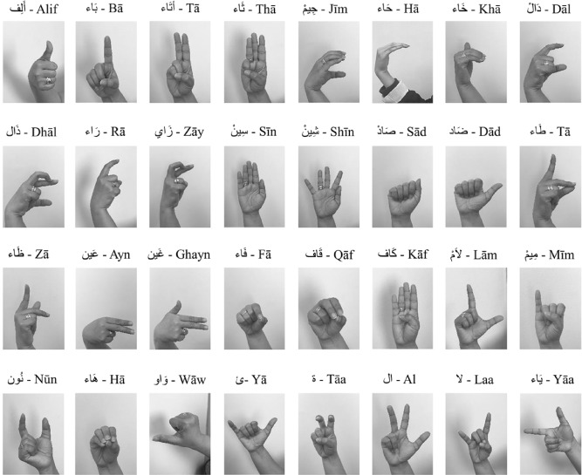
Collect Data
The data we will use in our model is a database which includes for each letter a huge set of images. These images is basically slices from a video captured for the hand gestures from different directions and views, with considering the light effect differences.

Slide 7






Features of Our Dataset
It considers multiple skin colors
It considers multiple background colors
It considers different poses directions
It considers hands with long sleeve clothes
It considers the hand accessories

Slide 8
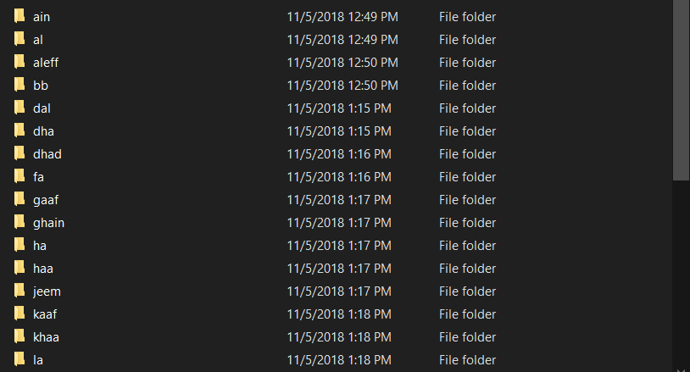
Label the Data
Each images set for each letter should be organized under one folder. Each folder should be named with the respective letter name.

Slide 9
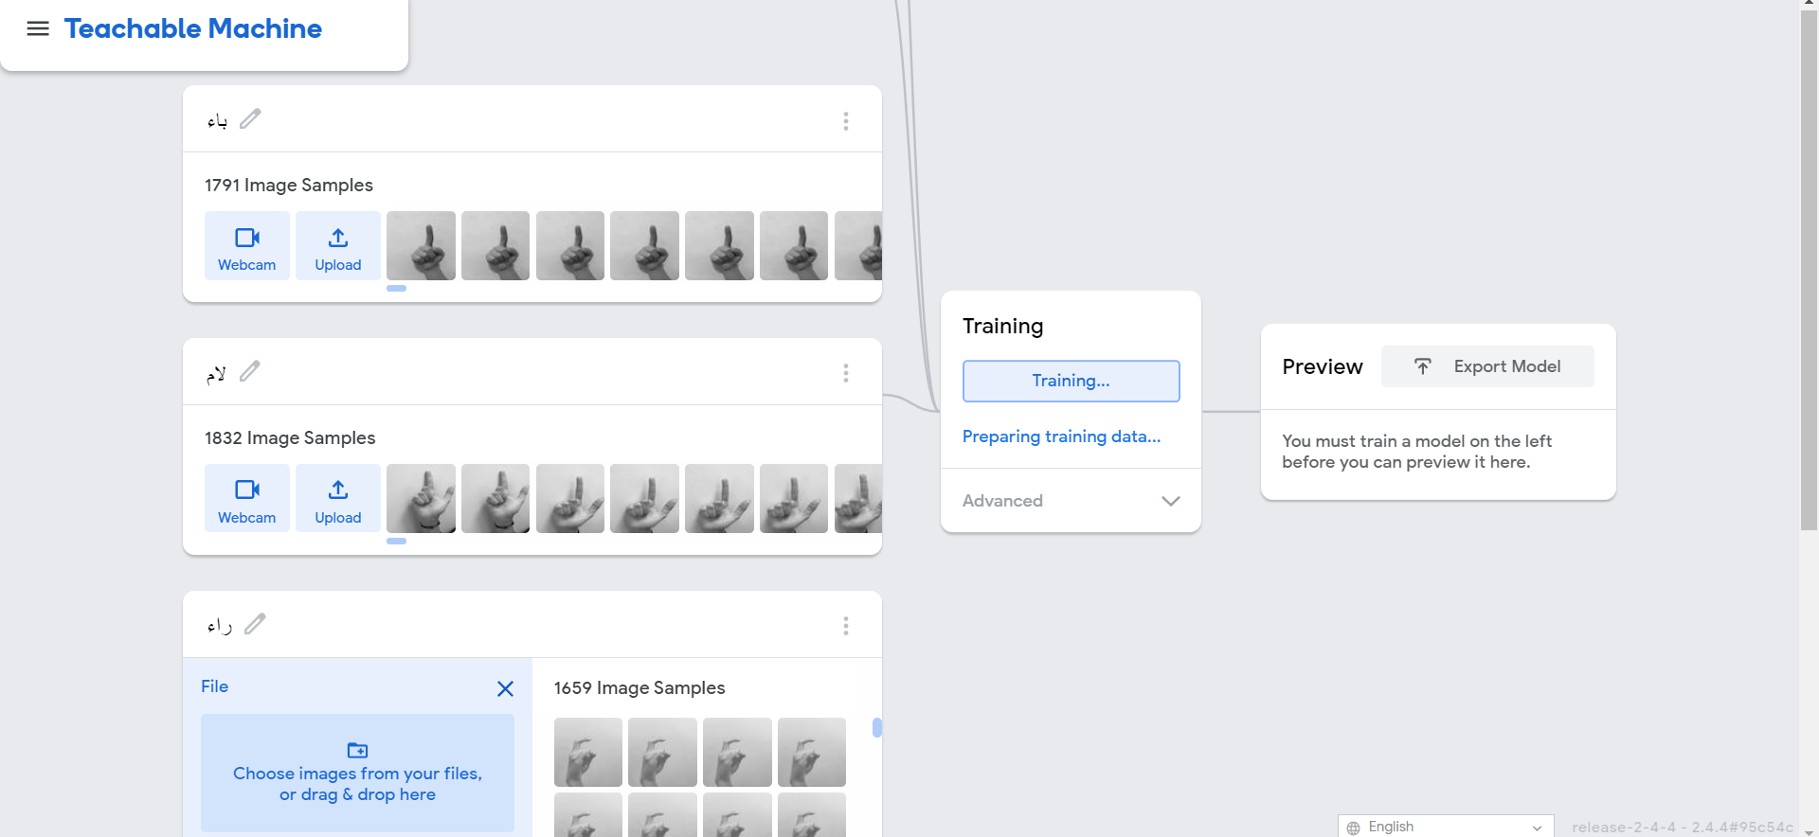
Train the Initial Model
Using Google teachable machine, we did an initial training for our dataset by including some letters as classes in order to prove the concept

Slide 10
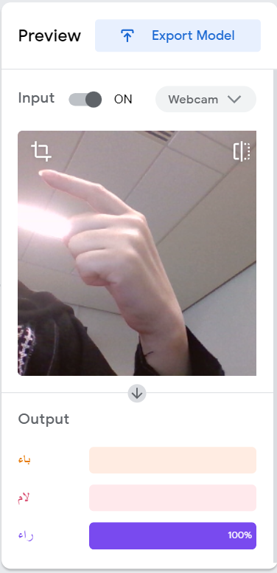
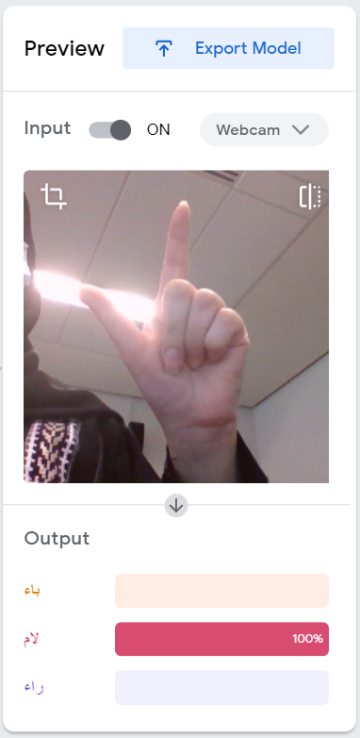
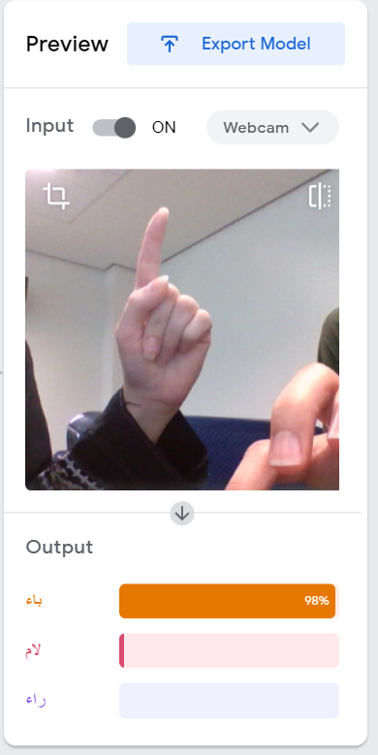
Model Initial Testing
Test sample examples from our database using Google Teachable Machine
Result: The machine could recognize some hand gestures in high accuracy (>90%), but there are some that caused a confusion for the machine

Slide 11
Build Software for Our Model
The plan is to build a software that use our model to recognize the different sign gestures and connect the respective letters to form words or complete sentence.
Our program is mainly use two libraries, which are TensorFlow and OpenCV
TensorFlow is mainly an open-source library that help us to train our ML model via a python code.
OpenCV is the library responsible for real-time computer vision. It helps us with real time sign language recognition.

Slide 12
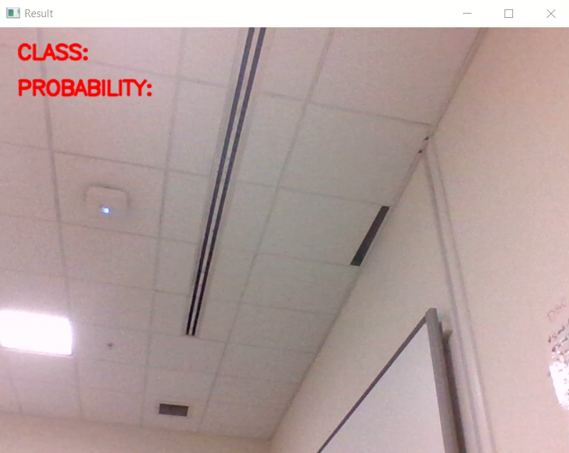
Iteration 1: Implement Image Classification Concept
We start developing a program that implement the concept of image classification.
Image Classification refers to images in which only one object appears and is analyzed. It attempts to comprehend an entire image as a whole in order to classify it to its assigned label.
Result: Our model detects a minor number or our 32 classes → bad detection
The first two letters is detected correctly, but the followed ones gives wrong results.

Slide 13
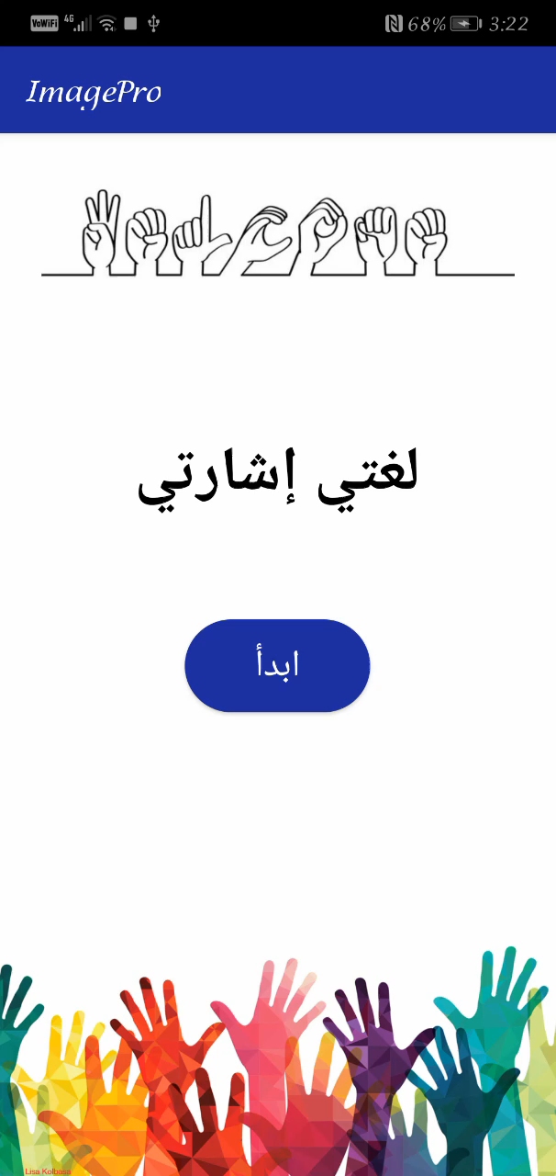
Iteration 2: Implement Object Detection Concept
We developed an Android mobile application that implement the concept of object detection.
Object Detection involves both classification and localization tasks. It helps to identify the location of a single object in the given image in case we have multiple objects present.
Our aim was to detect the hand position first, then classify the image within the contour to its assigned label. This technique should improve the detection process as it separates the hand from the background noise.
Result: Our model is improved, and most of the letters could be detected by the app.
Model with 10 letters, epochs = 40, batch size=32

Slide 14




Improve the Dataset
Far hand image
We did some elimination for the images that may confuse the machine and limit the hand gesture detection, such as the far hands images or the ones that show the whole forearm. Also, we eliminated the images that shows side hand poses cause a confusion for the model as hands from sides are not showing a clear gestures
Result:
An extra improvement detected in our model
Forearm image
Side pose of the same gesture

Slide 15
Test the Final Model
Test the accuracy of our model by training all the dataset we have in one model and detect any letters conflicts and inaccurate detection.
We are trying to improve our model now by trying different values of training parameters such as batch size and epochs.
Notes:
We noticed that our model improves when we reduced the batch size( we started with 96 then we tried 64 and 32) and increased the epochs( we started with 30 then 40, and now we want to try increasing and observing the result).

Slide 16
Expected Deliverables
1. Progress videos and presentations
2. Technical report
3. Software for sign language detection
For each task, the workload will be distributed evenly between the team members.

Slide 17


